Slide 1
Lecture 12a Randomized Algorithms

Slide 2
Recall: Dealing with Hard Problems
In order to deal practically with hard computational problems, one must often accept weakening of the requirement to guarantee computing the correct result. This can be done in different ways:
Accept a “reasonable” solution which is not exactly correct or, for optimization problems, is slightly suboptimal. The result of this approach is the so called approximate algorithms.
Accept that the probability for finding a correct, or optimal solution may be slightly less than 1 – randomized algorithms.

Slide 3
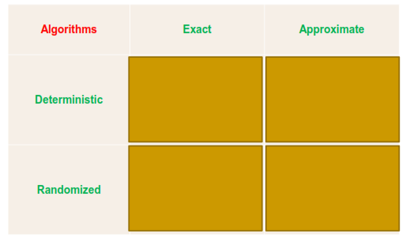
Classification of Algorithms (especially when dealing with hard problems)

Slide 4
Recall: Dealing with Hard Problems
This leads us to two independent divisions of algorithms:
Exact (precise) algorithms vs. approximate algorithms
Deterministic algorithms vs. randomized (stochastic, probabilistic) algorithms

Slide 5
Recall: Randomized Algorithms
In a randomized algorithm there are steps in the algorithm where random choice of two transitions is possible (the probability for each choice is ½). For different executions of the algorithm possibly different choices will be randomly made.

Slide 6
Recall: Randomized Algorithms
A randomized algorithm that always (independently of the random choices) produces the correct output and only the complexity of the algorithm can be considered a random variable, is called a Las Vegas algorithm. (That means that a Las Vegas algorithm is actually an exact, but not deterministic algorithm.)
In general, however, the output for a given input may be considered as a random variable – such randomized algorithms are called Monte Carlo algorithms.
But we can make the probability of calculating a wrong result as small as we want
The wrong results are sometimes called false positives / false negatives

Slide 7
Classification of Algorithms (especially when dealing with hard problems)
Las Vegas
Monte Carlo

Slide 8
Incorrectness can be ignored
For Monte Carlo algorithms, we demand that the possible incorrectness is something that can safely be ignored due to its low likelihood of occurrence.
If there is a slow deterministic algorithm, hardware errors are possible, and the probability that the deterministic algorithm will be correctly executed might be less than the probability that a fast randomized algorithm will produce a correct result.

Slide 9
Effect of randomness
The consequence of adding randomness may turn out to be surprising. Rather than producing unpredictable results, the randomness introduced may be extremely useful and capable of yielding fast solutions to problems that have only very inefficient (possibly intractable) deterministic algorithms.

Slide 10
Characterization of randomized algorithms
Advantages:
Often the time or space efficiency is better than any known deterministic algorithm
Often a deterministic algorithm with a bad worst case can be converted into a randomized algorithm with good expected efficiency with high probability on every input (see quicksort)
Often the randomized algorithms are very simple to comprehend and implement
Of course, not always using a randomized algorithm is a good idea

Slide 11
See pdf of Weiss

Slide 12
Average case running time for deterministic algorithms
For deterministic algorithms we use average-case running time, usually assuming a uniform distribution of all inputs.
If the input distribution is not uniform the result will be misleading
Example: an array has been sorted, a few new elements have been added and we need to sort the array again. It is actually almost sorted (and will lead to an almost worst-case running time in quicksort). The input distribution is not uniform.

Slide 13
Expected running time for randomized algorithms
For randomized (Las Vegas) algorithms, for the same instance I, the running time may be different.
We use expected running time on a fixed instance I. This is the mean time to solve the instance I over and over (average over all possible random numbers for this particular instance).
We talk about [?]
Average case expected time
Worst case expected time

Slide 14
Simple Example
Input: An array of n≥2 elements (even n), in which half are ‘a’s and the other half are ‘b’s.
Output: Find the index of an ‘a’ in the array.
We give two versions of the algorithm, one Las Vegas algorithm and one Monte Carlo algorithm.

Slide 15
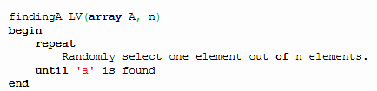
Las Vegas algorithm
This algorithm succeeds with probability 1.
The running time is random.
return index of the element
end

Slide 16
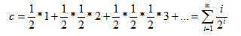
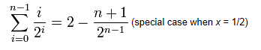
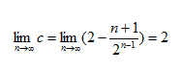
Analysis of expected time
Worst case: ∞
Average case: 2 [Θ(1)]
[ a ba bba ]
but
In average in 2 steps we’ll find an “a”

Slide 17
Analysis of expected time
Average case: 2 [Θ(1)]
c = 0.5 + 0.5 + 0.375 + 0.25 + 0.15625 + 0.09375 + 0.0546875 + … =
1.9296875 + …

Slide 18
Recall: Las Vegas algorithm
This algorithm succeeds with probability 1.
The running time is random.
return index of the element
end

Slide 19
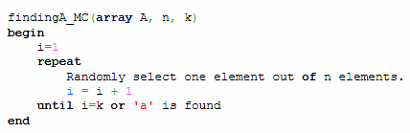
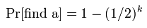
Monte Carlo algorithm
If an ‘a’ is found, the algorithm succeeds, else the algorithm fails.
After k iterations, the probability of finding an ‘a’ is and can be done as near 1 as we wont by increasing k.
This algorithm does not guarantee success, but the run time is fixed. The selection is executed not more than k times, therefore the runtime is O(k).
return index of the element
end
bbbbbbbb

Slide 20
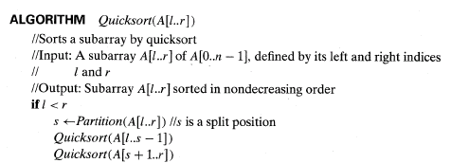
Recall: QuickSort Algorithm
Originally the pivot is at position low, after partitioning is swapped with the element in position s
A[0],….A[s-1], A[s], A[s+1], …, A[n-1]
all are <=A[s] all are >=A[s]

Slide 21
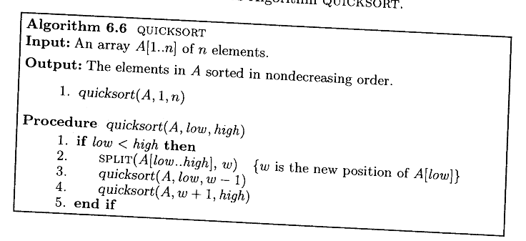
Same algorithm – another presentation
s in previous page

Slide 22
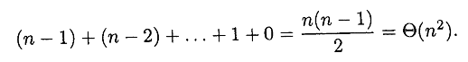
Analysis of simple QuickSort
In average Θ(nlogn)
However, in the worst case Θ(n²)
Comparisons
We need to improve the case when the array is almost sorted (this happens pretty often in practice)

Slide 23
Introduce randomness
Preprocessing – randomly permute the elements to be sorted: Θ(n) for preprocessing
Choose pivot randomly
using function random(low,high) which returns a number between low and high randomly (with equal probability 1/(high-low+1)
Weiss Java, Alsuwaiyel

Slide 24
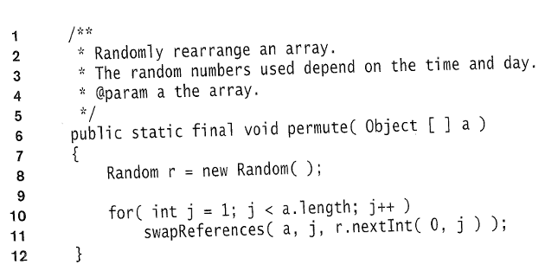
Preprocessing

Slide 25
Recall: Same algorithm – another presentation

Slide 26
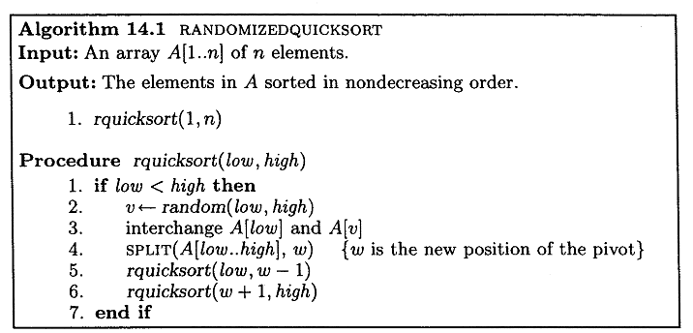
Randomized QuickSort

Slide 27
Recall: Analysis of Quicksort
Best case: split in the middle — Θ(n log n)
Worst case: sorted array! — Θ(n²) bad!
Average case: random arrays — Θ(n log n); ≈1.4nlog₂n

Slide 28
Analysis of randomized Quicksort
Worst case: still Θ(n²)
However, this is not attributed to the input; if it does happen then it is because of the unlucky random pivots chosen by the random number generator, which is very unlikely
Average expected time = average case for simple QuickSort: Θ(nlogn)
The cases do not depend on the input now but rather on chance! We do not need to assume that all permutations of the input elements are equally likely.

Slide 29
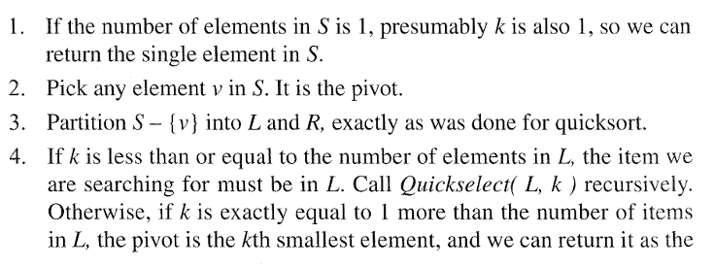
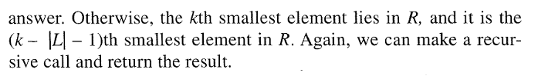
QuickSelect
Find the kth smallest element in an array of n items.
- If sort first: Θ(nlogn)

Slide 30
QuickSelect
Difference from QuickSort – only one recursive call in QuickSelect compared to two in QuickSort.
Worst case – still Θ(n²)
Average case - Θ(n) instead of Θ(nlogn)

Slide 31
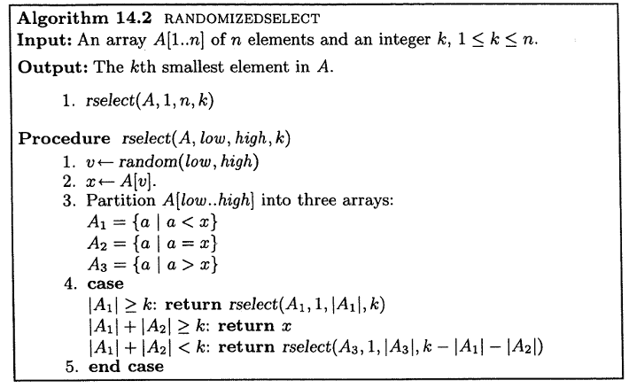
Randomized QuickSelect

Slide 32
Randomized QuickSelect
Theorem [Alsuwaiyel]
The expected number of element comparisons on input of size n is less than 4n. The expected running time is Θ(n)

Slide 33
QuickSelect
Other randomized algorithms
[Alsuwaiyel, Lee, Kleinberg, Moore]
Testing string equality
Pattern matching
Random sampling
Primality testing
Closest pair
Interactive proofs
Minimum spanning tree (linear time)
Contention resolution
Global minimum cut
MAX 3-Sat
Hashing (dictionaries)
Load balancing
Packet routing
Randomized Turing Machine
…

Slide 34
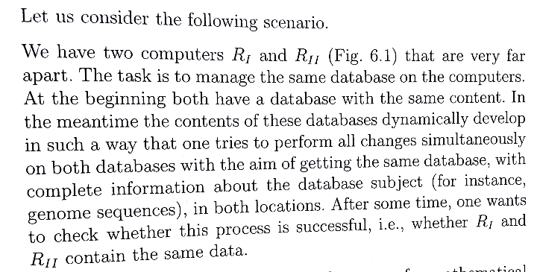
Communication channel
Hromkovic – Algorithmic Adventures

Slide 35
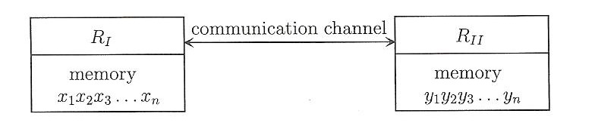
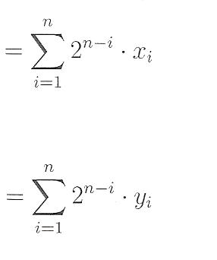
Communication channel
x
y
Are the two numbers equal?

Slide 36
If we use a deterministic algorithm we need to send about n bits. This is not realistic for large n, for example n = 10¹⁶.
Heavy communication costs.
There is no chance that there will be no error in the communication!

Slide 37
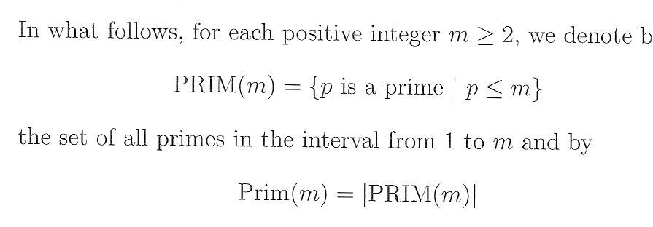
by

Slide 38
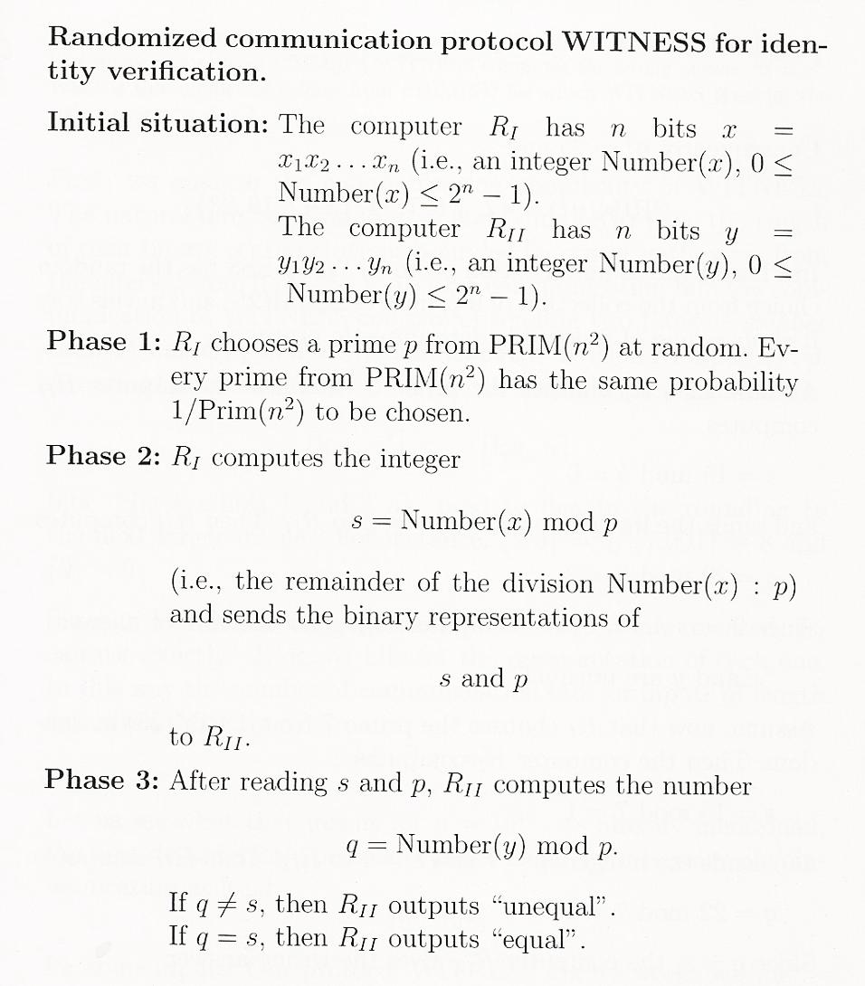
Send p and s
s = x mod p
q = y mod p

Slide 39
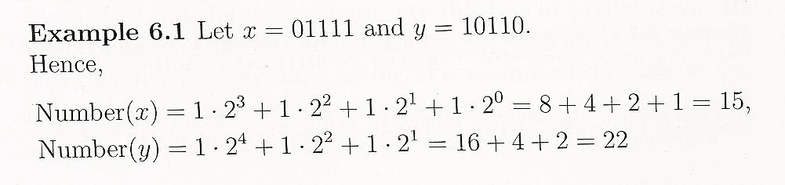
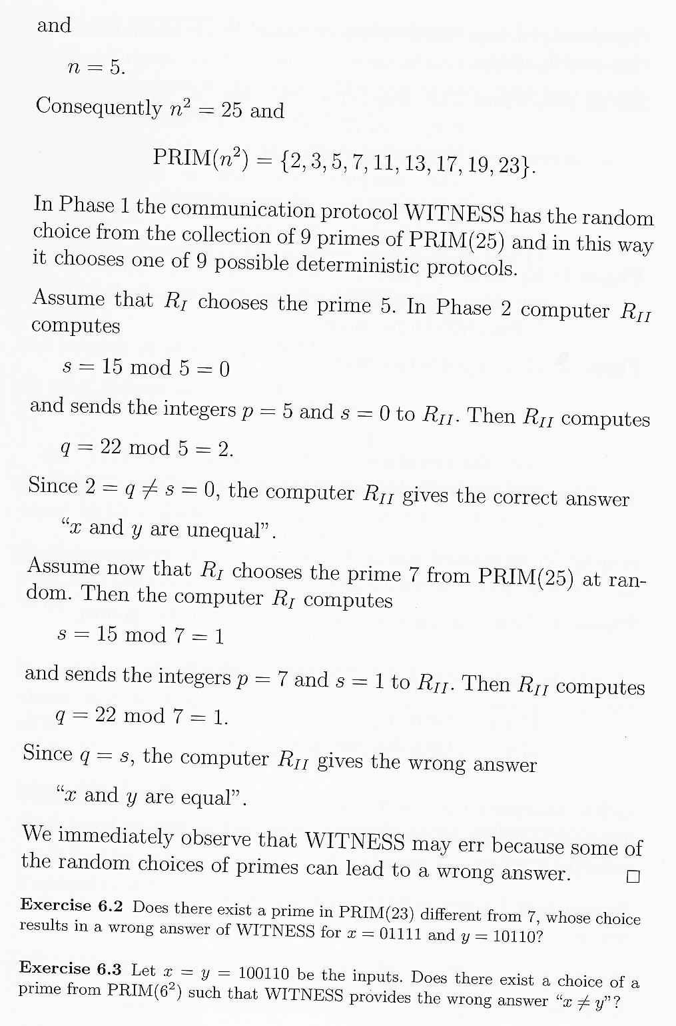
x
y

Slide 40
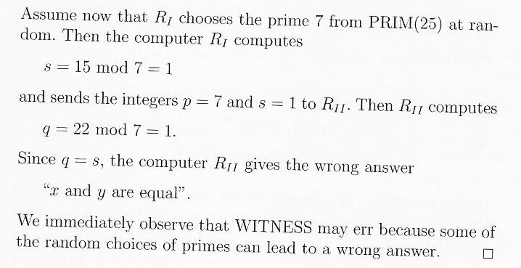
R1 sends two numbers (p and s) <= n²

Slide 41
Communication complexity
2 numbers are sent from R1 to R2: p and s
Both are <= n²
To represent numbers up to n² we need m bits
0 <= n²<= 2^{m} -1,
or 2^{m} > n², m = ⎡log₂(n²)⎤ = 2 ⎡log₂(n)⎤
To send p and s we need 4 ⎡log₂(n)⎤ bits

Slide 42
Communication complexity
If n = 10¹⁶ , 4 ⎡log₂(n)⎤ = 256 bits !!!
(instead of 10¹⁶ for a deterministic algorithm)

Slide 43
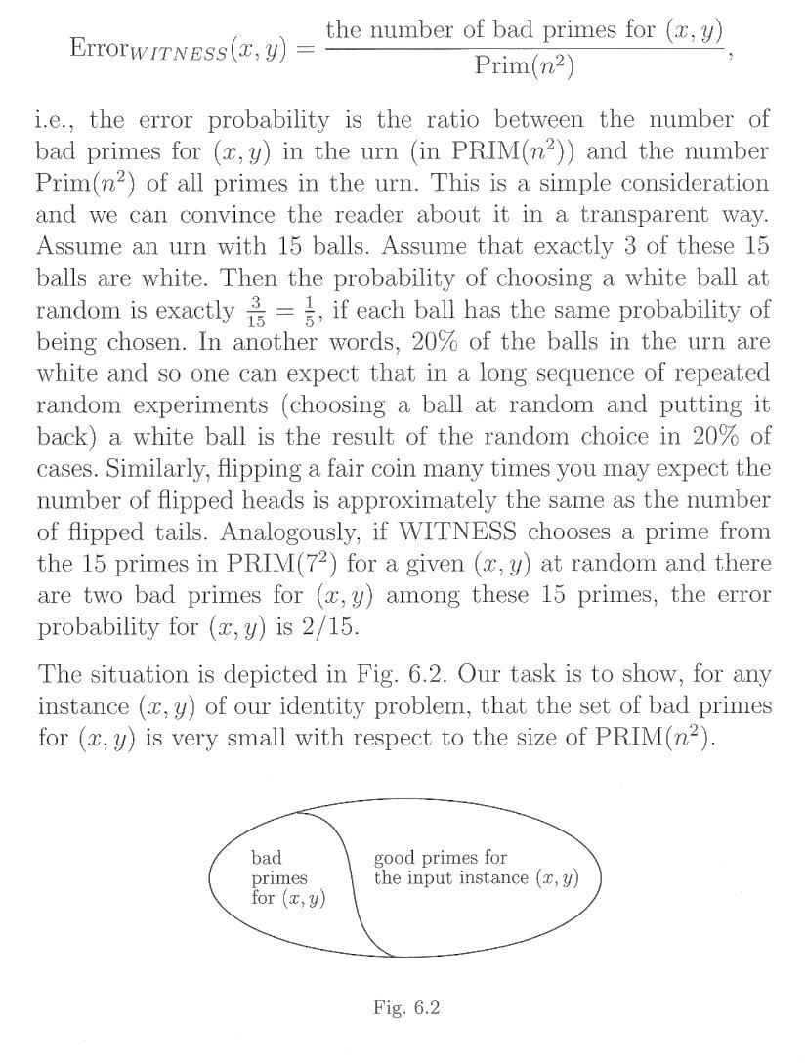
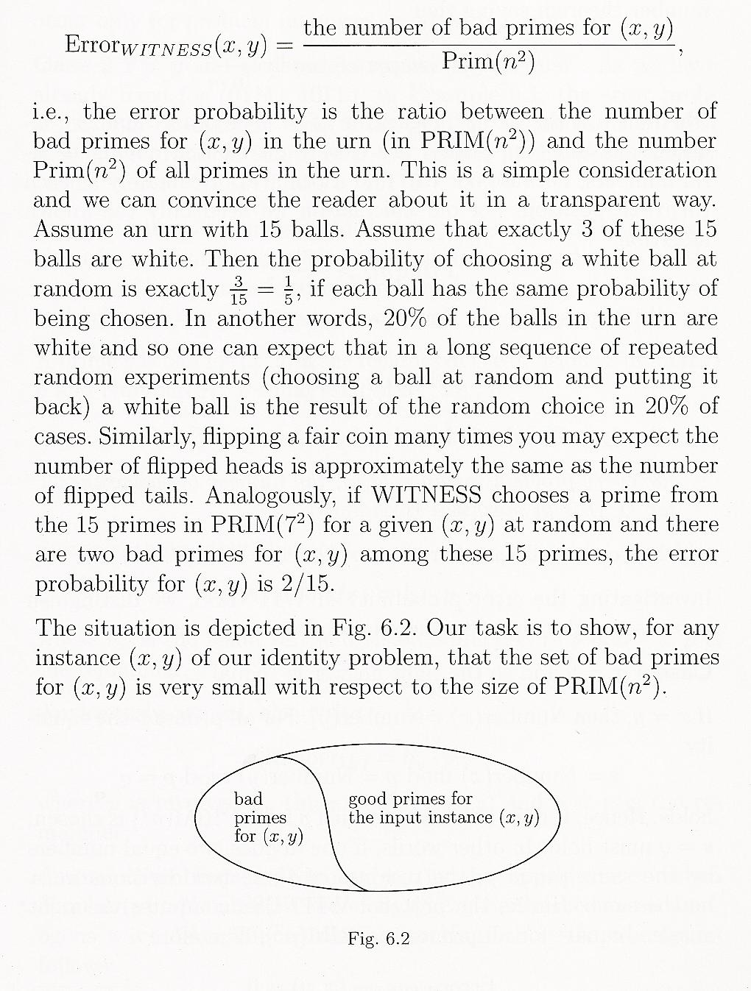
Error probability
witnesses
Non- witnesses
7
5
candidates for witnesses
(5 is a witnesses for <15,22>)
5 is a good prime for (01111, 10110)
7 is a bad prime for (01111, 10110)
(7 is not a witnesses for <15,22>)
For our example Error_{WITNESS}(15,22) = 1/9
Prim(n²) = 9. The only bad prime is 7

Slide 44
Number of primes
Theorem: For k > 67
Prim(k) >
For n >= 9
Prim(n²) >

Slide 45
A prime p is bad for (x,y) iff p divides Dif(x,y)
Indeed, x = kp + s
y = lp + s
x – y = (k-l)p

Slide 46
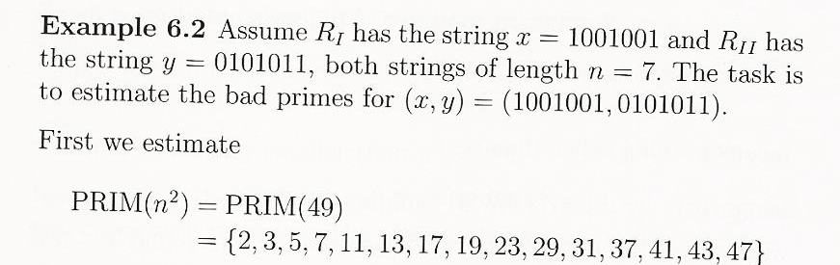
x = 73, y = 43, n = 7
The bad primes are the primes that divide (x – y)
73 – 43 = 30
Bad primes are 2, 3, 5

Slide 47
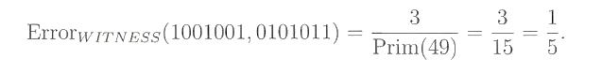
How to reduce the error? - below

Slide 48
For our previous example
x – y = 15 – 22 = -7
Therefore, the only bad prime is 7.
Error = 1 / 9

Slide 49
Can be proved that the number of bad primes for (x,y) is <= (n – 1)

Slide 50
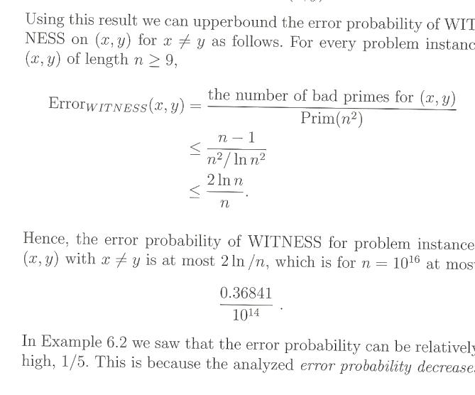
This algorithm is good for large n; for small n use a deterministic algorithm

Slide 51
Witnesses are randomly distributed among all candidates for witnesses – therefore a randomized algorithm is good (natural); no deterministic algorithm is natural

Slide 52
Reducing error
Run the algorithm t times!
If for at least one of these runs the result is negative, the overall answer is negative
If the error for one run is e, for t runs it will be e^{t}

Slide 53
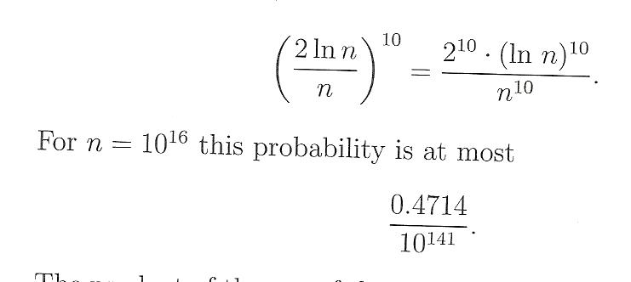
For our example, if we run WITNESS 10 times
The probability for error becomes
We can make it as small as we want!

Slide 54
The communication complexity for 10 runs will be only
10*4 * ⎡log₂(n)⎤ = 40 ⎡log₂(n)⎤
To send p and s we need 4 ⎡log₂(n)⎤ bits (p. 41)

Slide 55
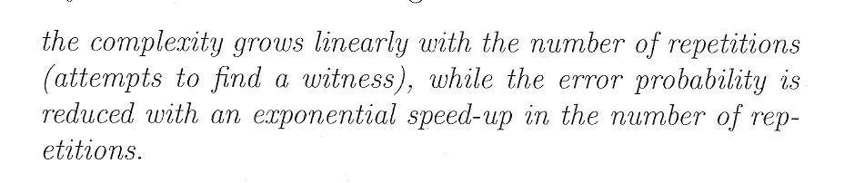

Slide 56
